Slide 1


K.RAMAKRISHNAN COLLEGE OF TECHNOLOGY
(AUTONOMOUS), TRICHY
ALUMNI MANAGEMENT SYSTEM
PRESENTED BY : SUPERVISOR:
VISHALINI V, Mr.A.Malarmannan,M.E.,
2303811710422180 AP/CSE.
Notes:
1

Slide 2
PRESENTATION OVERVIEW
Objective
Project Introduction
Problem Statement
Methodologies (Programming concepts relevant to problem statement)
Architecture of the proposed system
List of Modules
Merits
Results and Discussion
Queries
Notes:
2

Slide 3
OBJECTIVE
To create a system that helps institutions stay connected with their alumni, organize events, and make it easier for alumni to network and stay involved. The goal is to build stronger relationships and support both alumni and the institution’s growth. To build a system that keeps alumni connected with their institution and each other.

Slide 4
PROBLEM INTRODUCTION
The Alumni Management System aims to address the challenges educational institutions face in staying connected with their alumni. It simplifies the process of managing alumni data, organizing events, and promoting networking opportunities. By creating a platform that fosters communication and engagement, the system helps strengthen relationships between alumni and the institution, encouraging active participation and supporting mutual growth.

Slide 5
PROBLEM STATEMENT
Educational institutions face difficulties in managing their alumni network effectively. These challenges include maintaining up-to-date alumni information, organizing events that encourage alumni participation, and fostering communication between alumni and the institution. As a result, alumni engagement remains low, and opportunities for networking, career development, and institutional support are underutilized.

Slide 6
Methodologies (Programming Concepts Relevant to Problem Statement):
Object-Oriented Programming (OOP):Organize data using classes and objects to represent alumni and events
Use ArrayList to store and manage dynamic data for alumni events.
File Handling: Save and retrieve data using file operations to ensure persistence of alumni and event information.
GUI: Use Java AWT components like buttons, text fields, and labels to create an interactive and user-friendly interface.

Slide 7
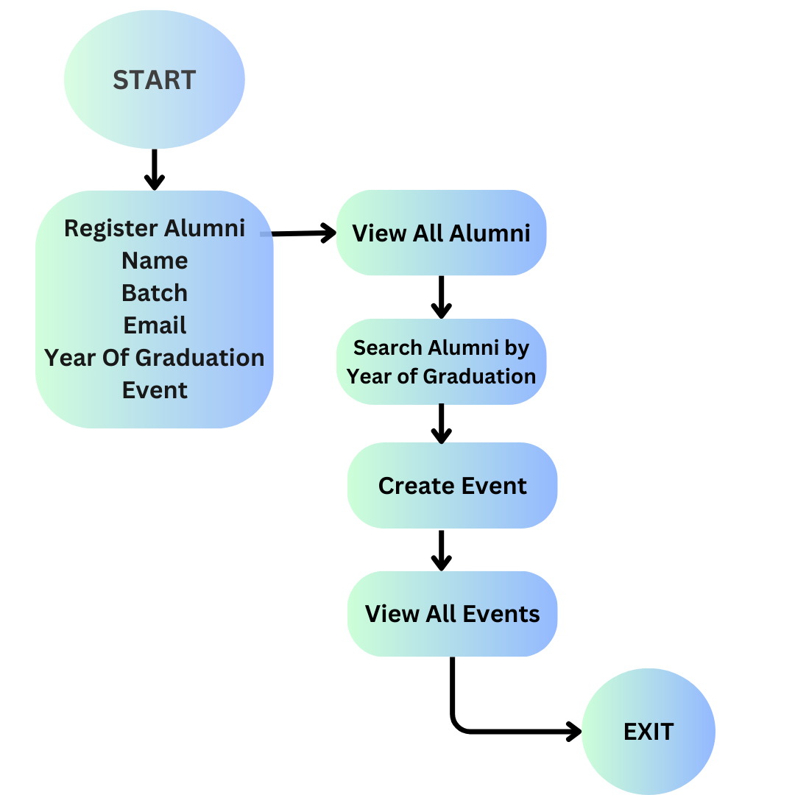
ARCHITECTURE DIAGRAM
IIIIIIIIIIIIIIIIIII
IIIII

Slide 8
MODULES
Register Alumni Module: allows alumni to enter their details and saves them in the system.
View All Alumni Module: displays a list of all registered alumni, showing their details like name, batch, email, and graduation year.
Search Alumni Module: allows users to search for alumni based on criteria such as a graduation year.
Create Event Module: allows users to create and add new events to the system, providing details like the event name.
View All Events Module: displays a list of all upcoming events.

Slide 9
MERITS
Event Organization: Simplifies planning and managing alumni events.
Networking: Helps alumni connect for job opportunities and mentorship.
Easy Communication: Makes it easier for alumni and the institution to stay in touch.
Data Storage: Keeps alumni information organized and accessible.

Slide 10
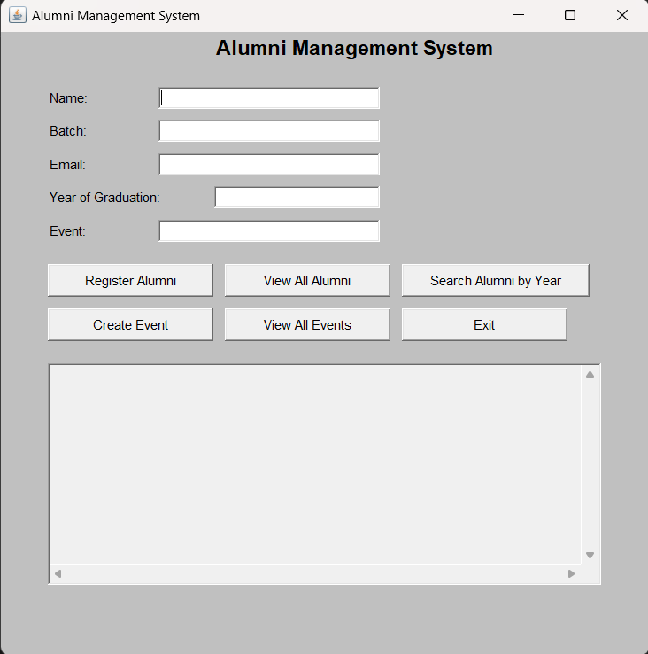
RESULTS AND DISCUSSION
ALUMNI MANAGEMENT SYSTEM

Slide 11
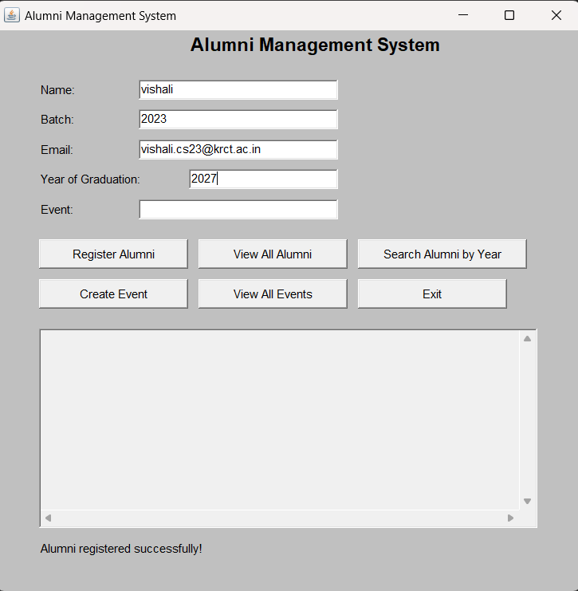
RESULTS AND DISCUSSION
REGISTER ALUMNI:

Slide 12
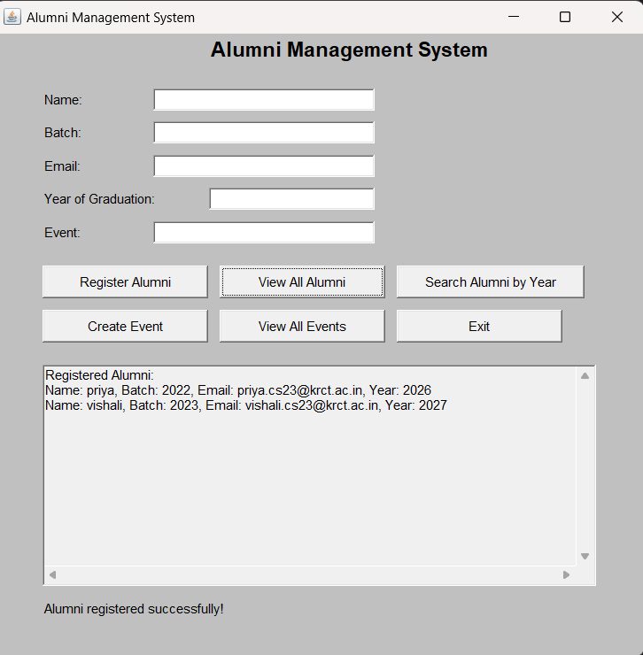
RESULTS AND DISCUSSION
VIEW ALL ALUMNI:

Slide 13
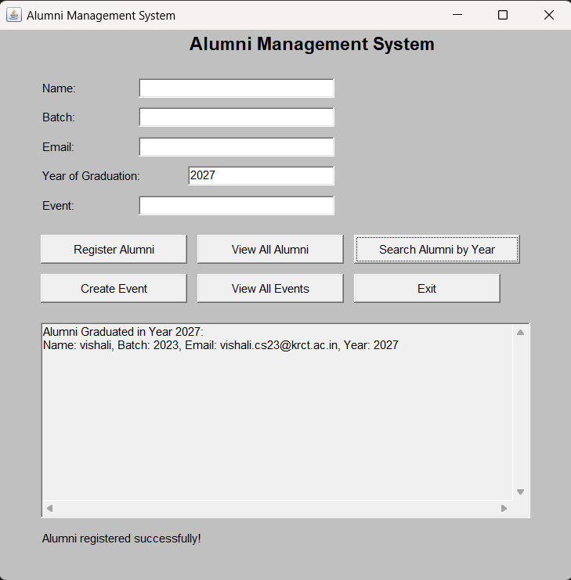
RESULTS AND DISCUSSION
SEARCH ALUMNI:

Slide 14
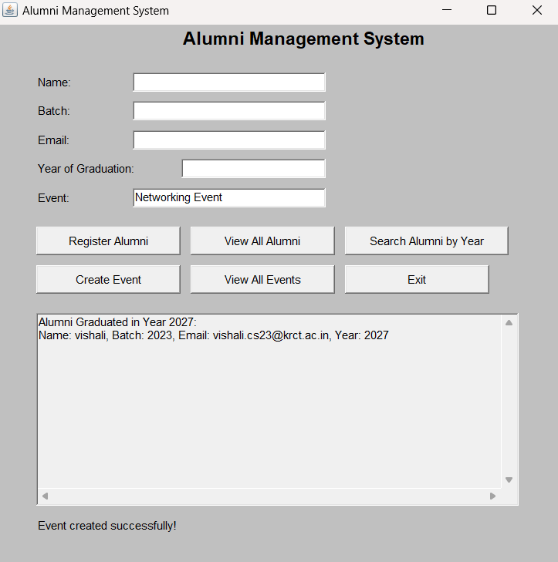
RESULTS AND DISCUSSION
CREATE EVENT:

Slide 15

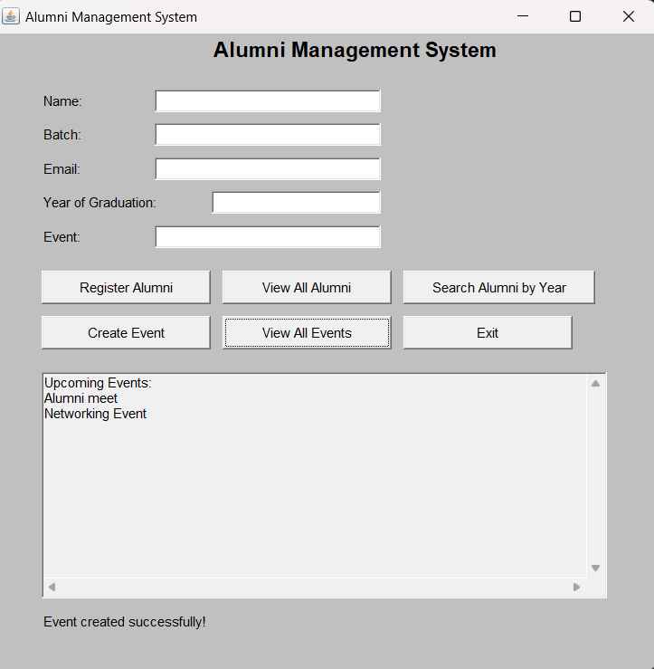
VIEW ALL EVENTS:

Slide 16
ANY QUERIES ?

Slide 17
THANK YOU

